Slide 1

Extending the Demo

Slide 2

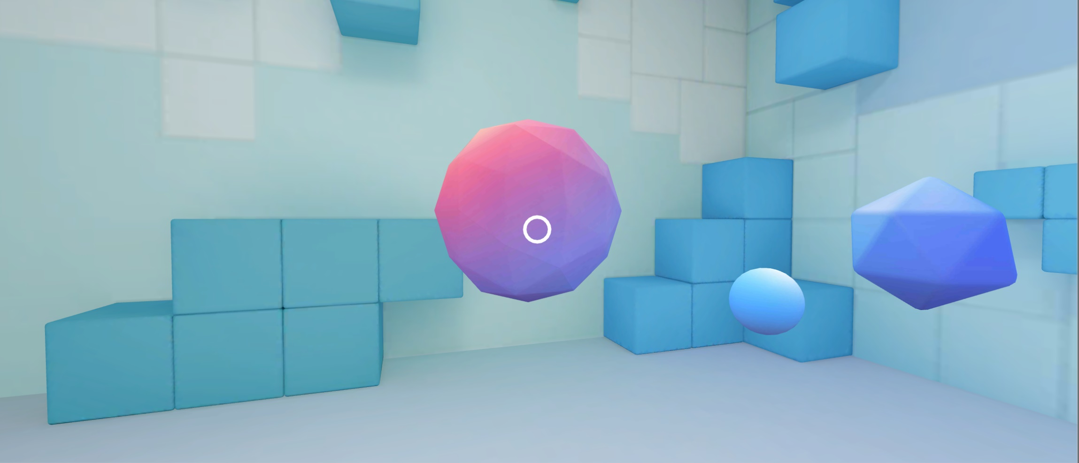
Extension 1 – Multiple, Spinning Treasures
Goals:
Have three treasures in the scene at the same time
Each treasure is a different shape
Have the treasures rotate when focused on the object

Slide 3
Extension 1 – Multiple, Spinning Treasures
Trying it on your own?
Quick hints:
You should probably be adding an update function
Line of code to make objects rotate: transform.Rotate(x, y, z);
Otherwise step-by-step instructions are next

Slide 4
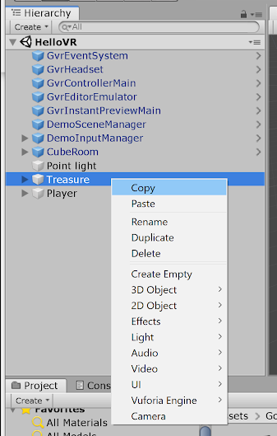
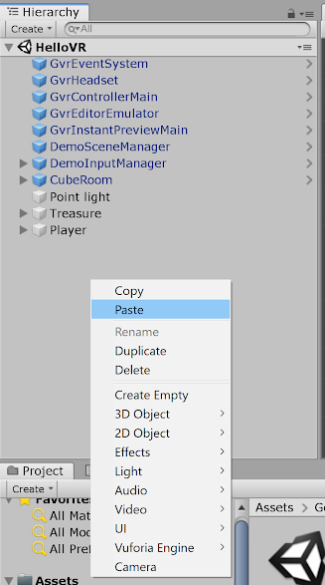
Create 3 treasure objects
Starting from the HelloVR:
Right-click the “Treasure” component and copy
Right-click anywhere in the gray space of the hierarchy and paste (and repeat)

Slide 5
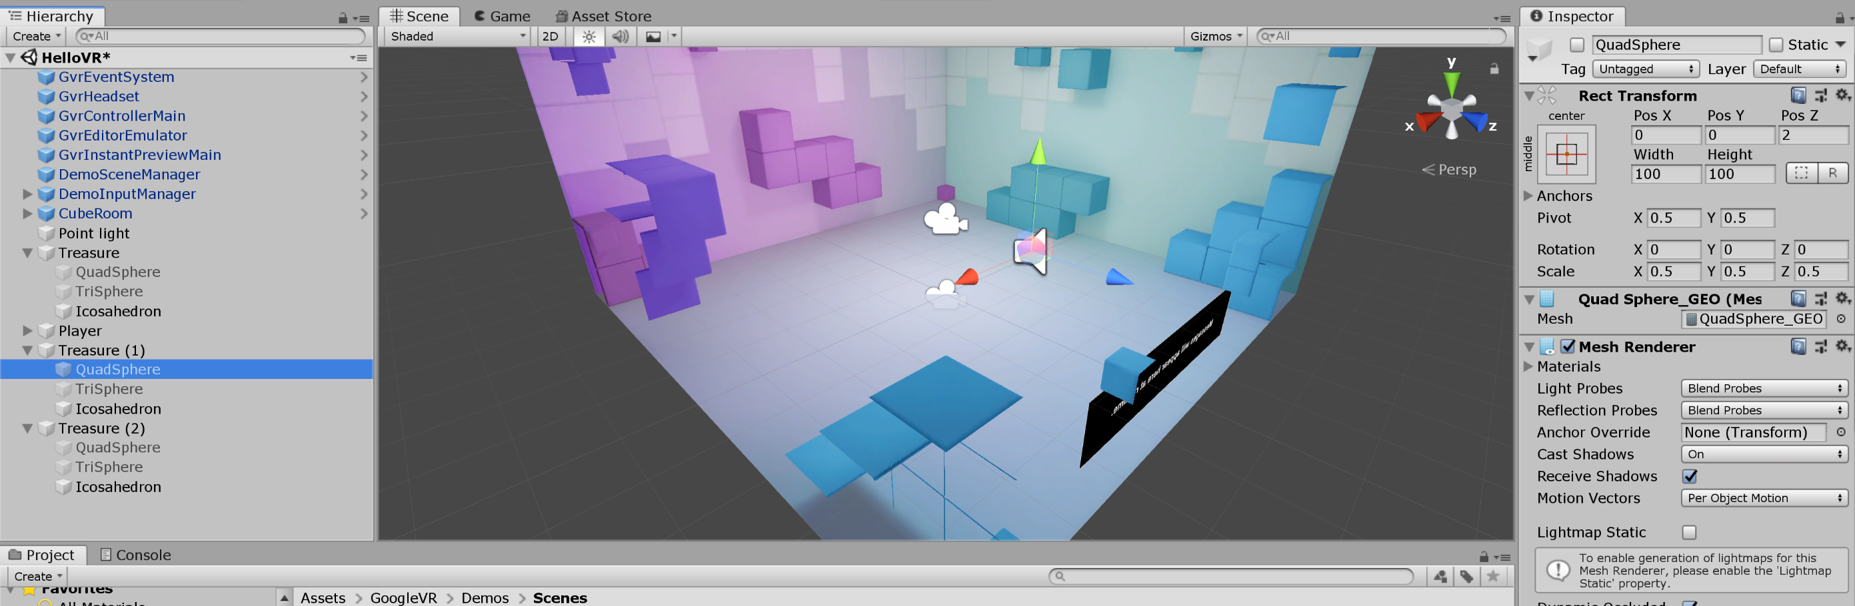
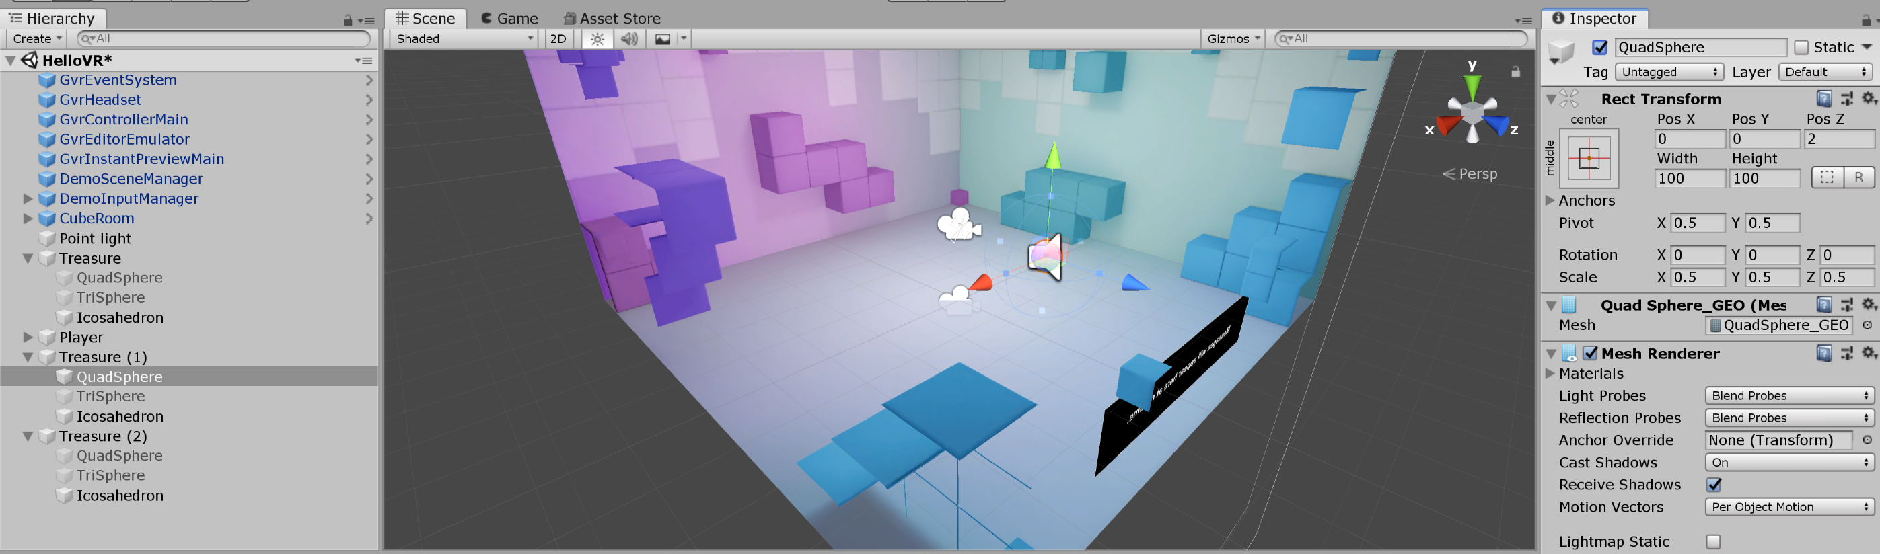
Have each be a different shape
Check the shape to be displayed

Slide 6
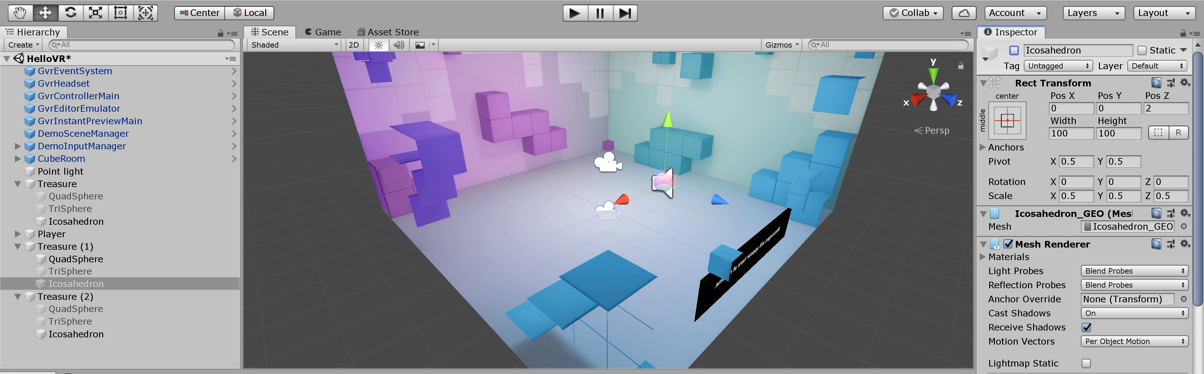
Have each be a different shape
And deselect the old displayed shape

Slide 7
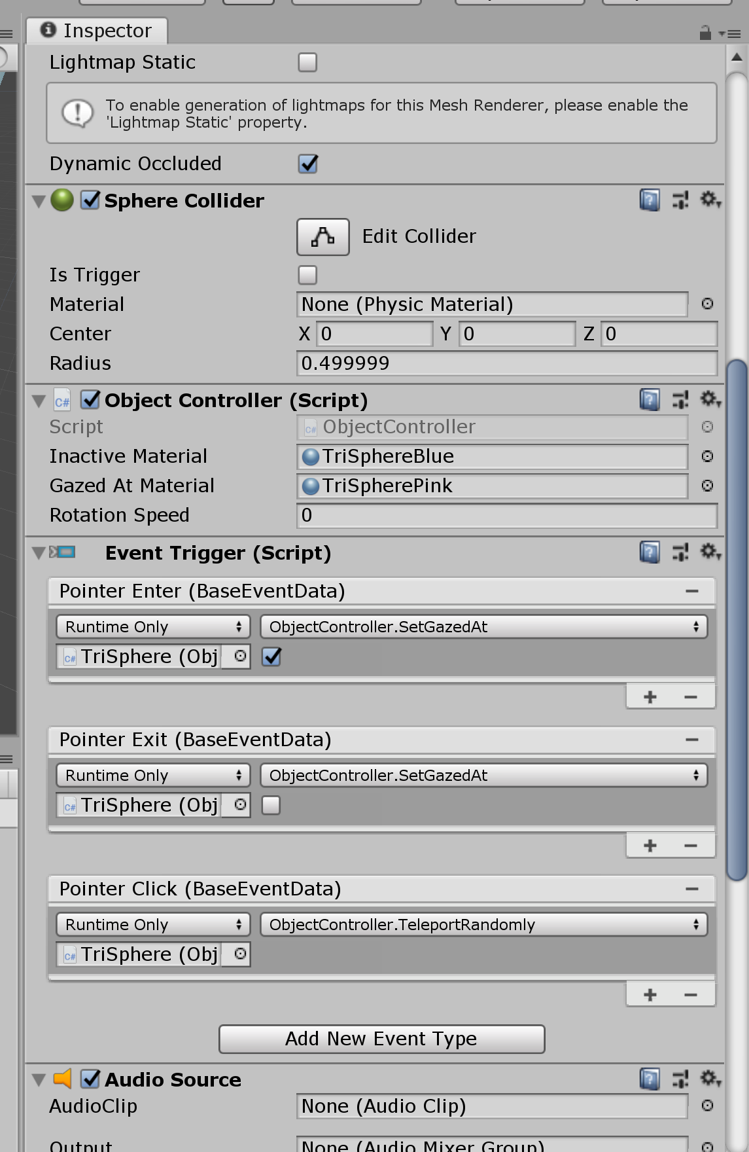
Add rotation
Scrolling down in the inspector, we see that in the event “Pointer enter” happens, the SetGazedAt function in ObjectController is triggered

Slide 8
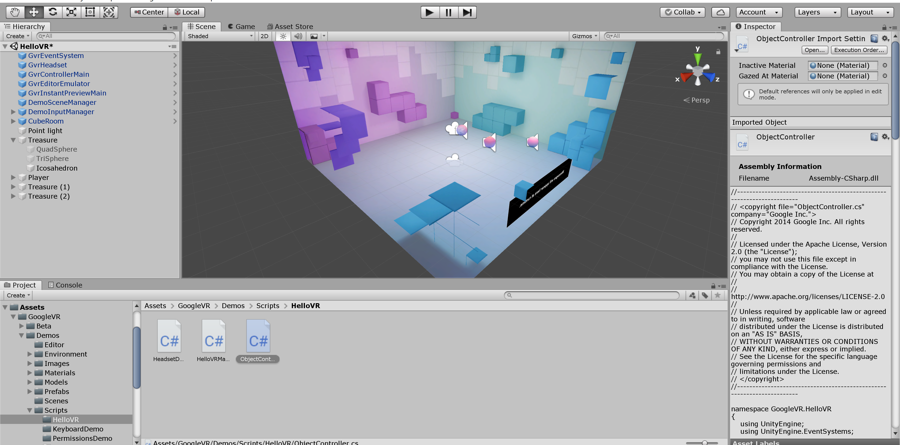
Add rotation
So we should navigate to, double click, and open the ObjectController script

Slide 9
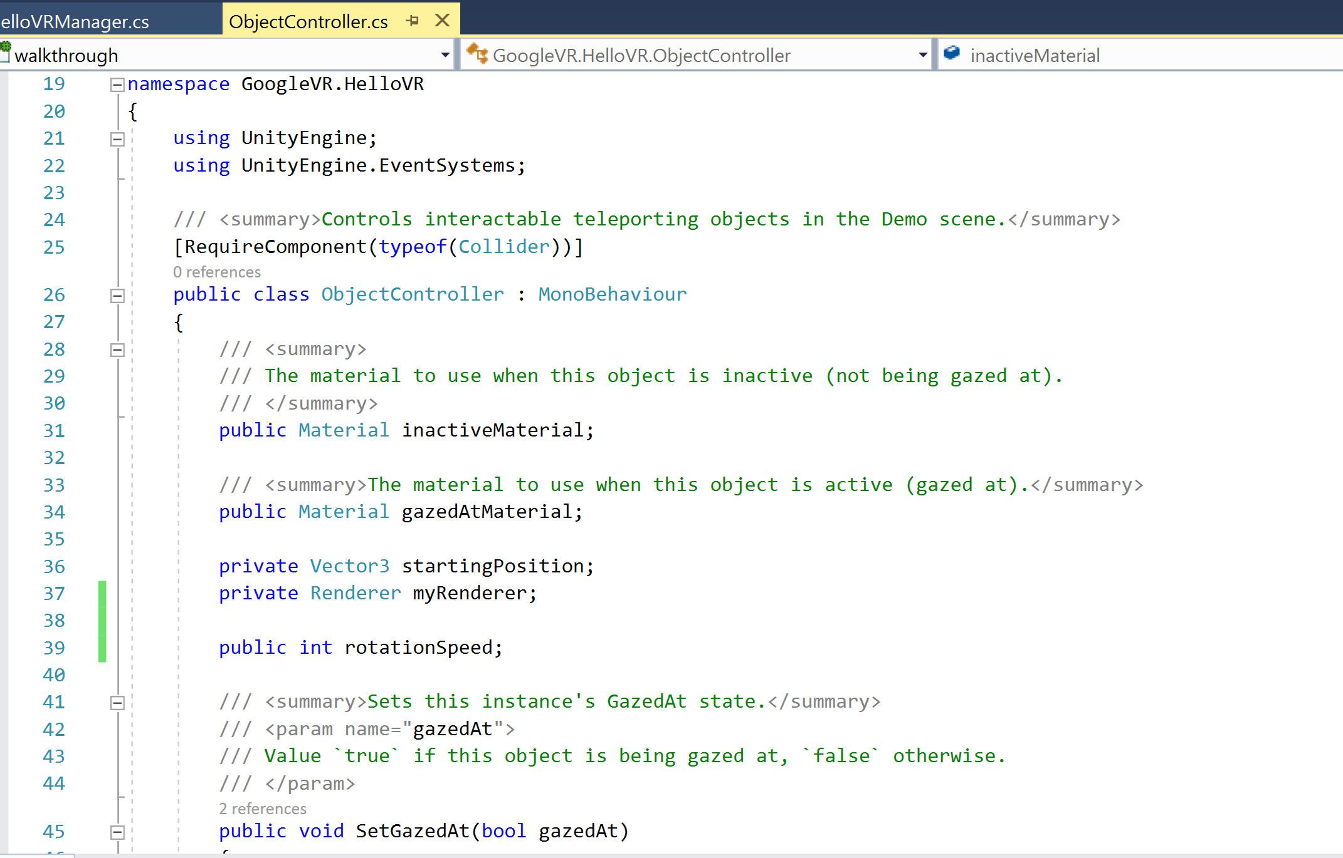
Add rotation
Add a rotation speed parameter

Slide 10
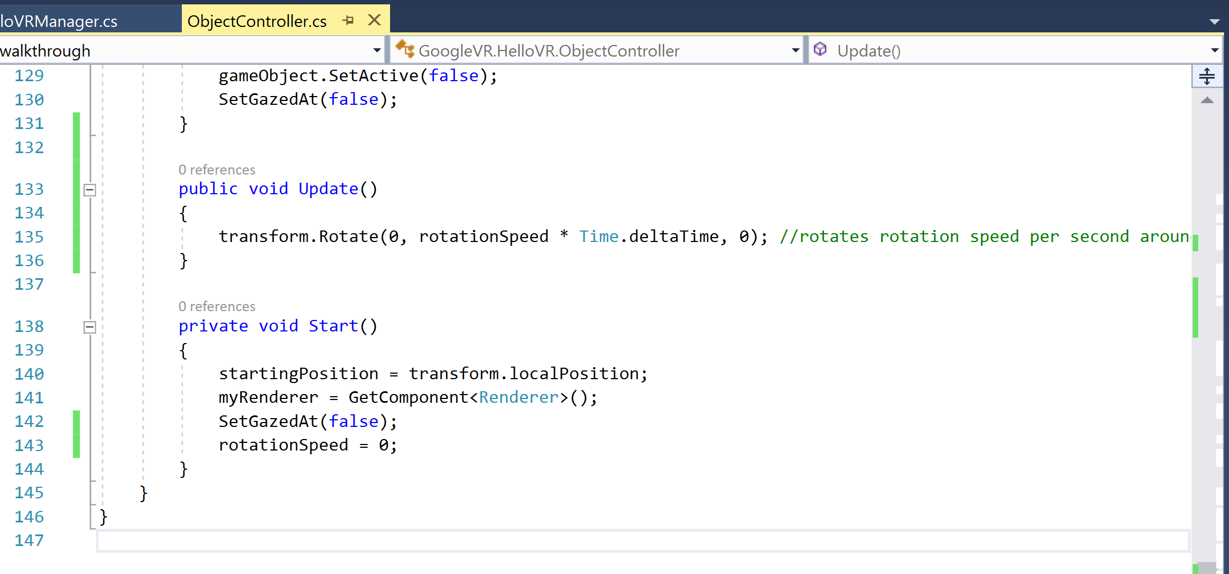
Add rotation
Add an update function so we can continuously rotate
Use the transform.Rotate function
Add a line so that rotation speed starts at 0 in the start function

Slide 11
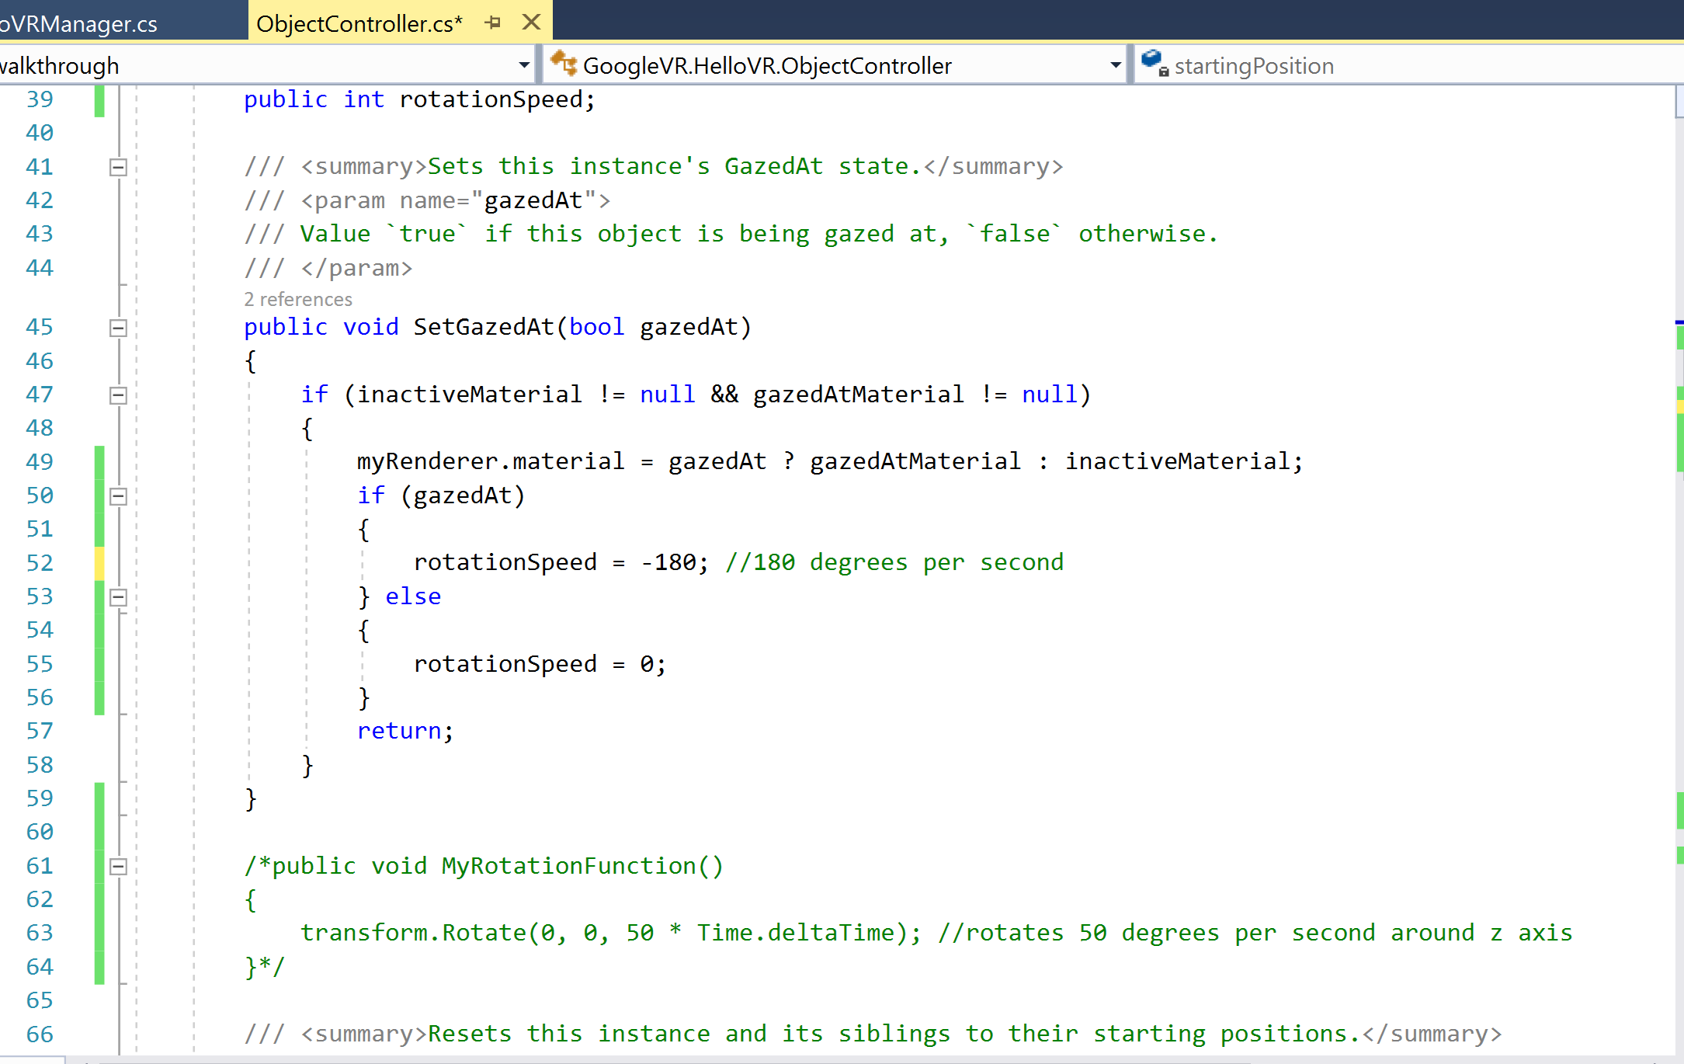
Add rotation
Find the “SetGazedAt” function from before
Now we should change the rotation speed so the object starts to rotate if the object is gazed at
Then change it back to 0 if the object is not being gazed at

Slide 12
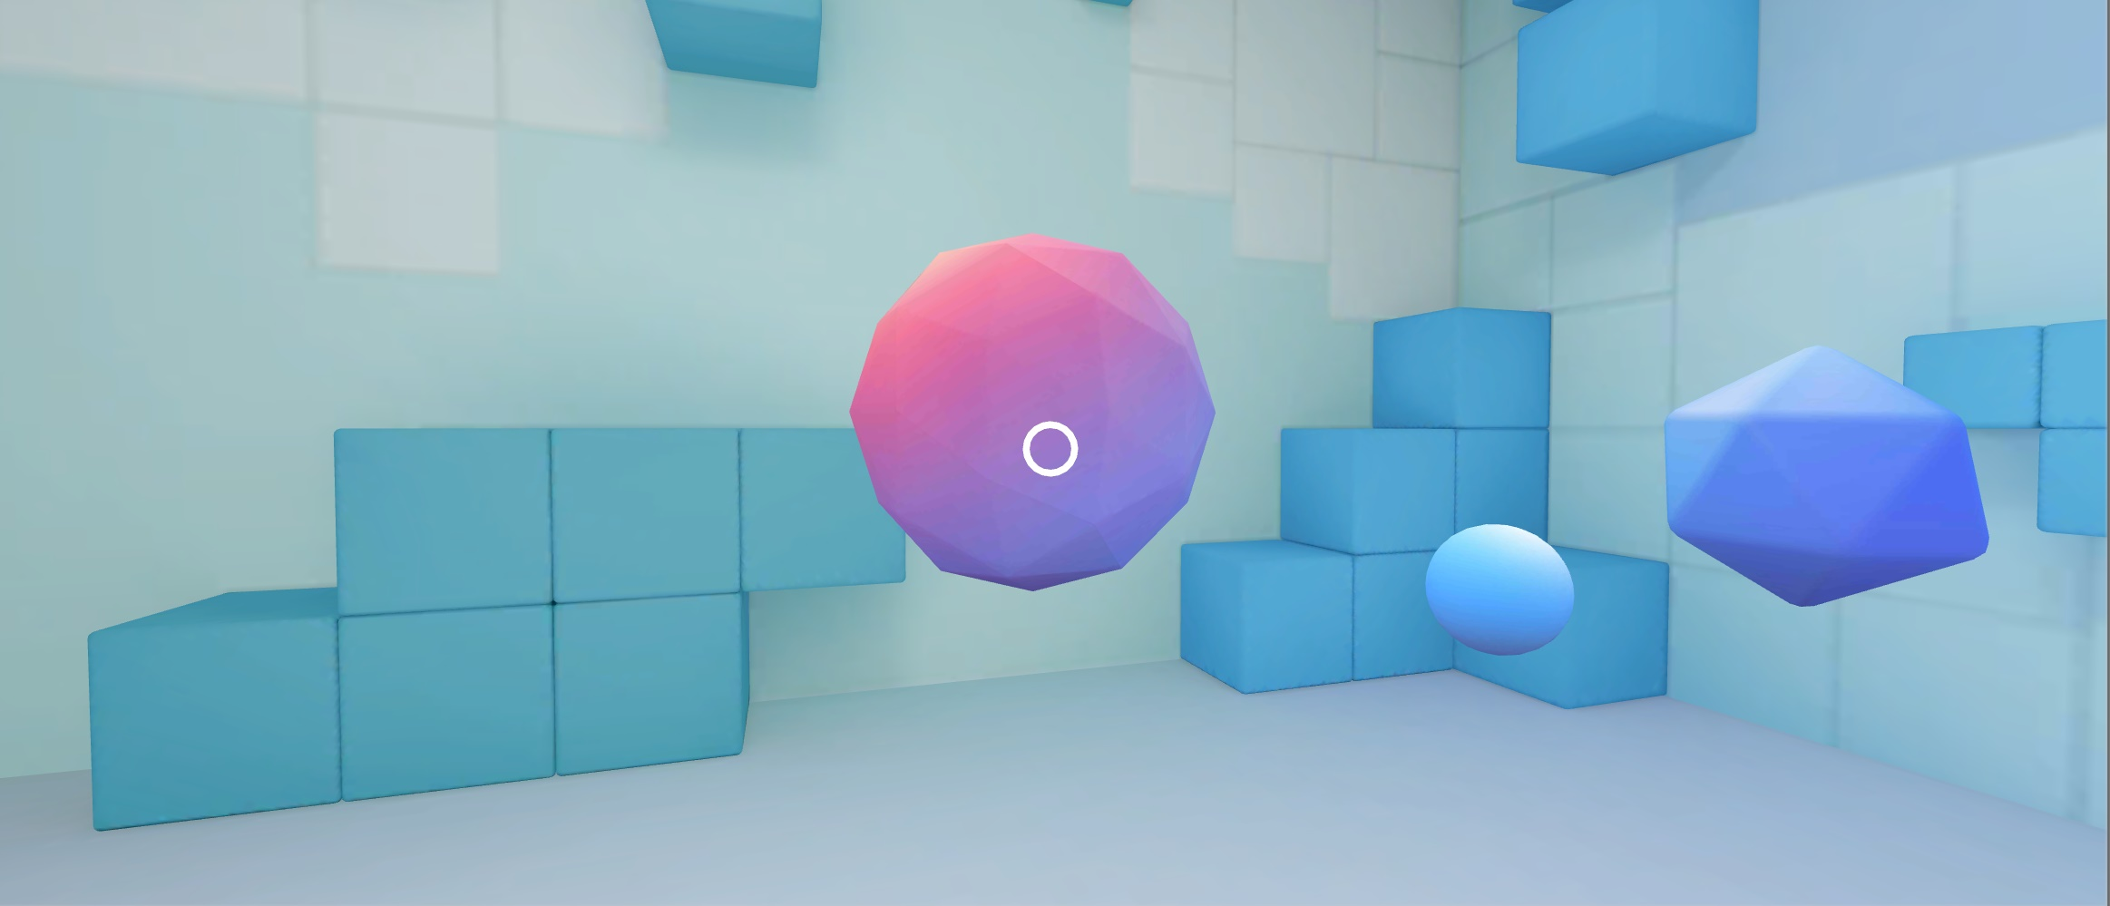
Try it out!

Slide 13
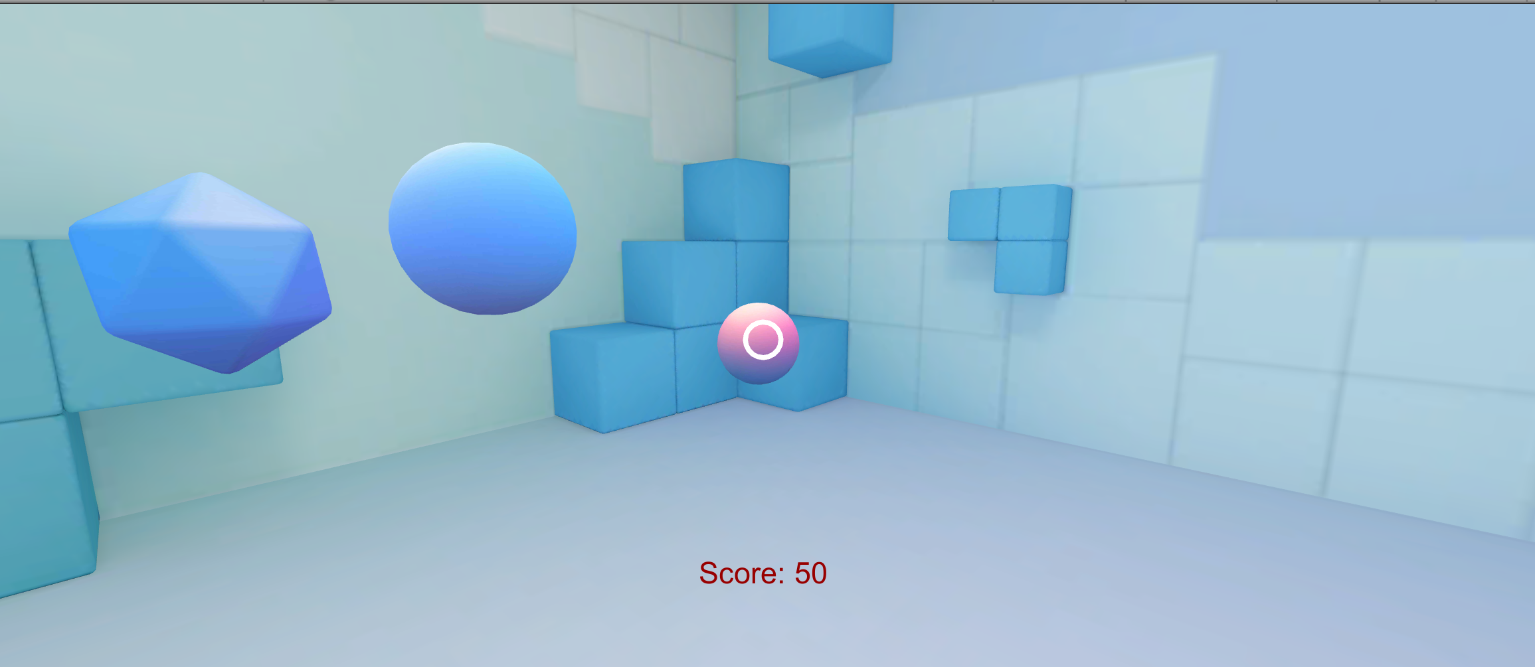
Extension 2 – Keeping score
Goals:
Display score
Score updates as objects are shot

Slide 14
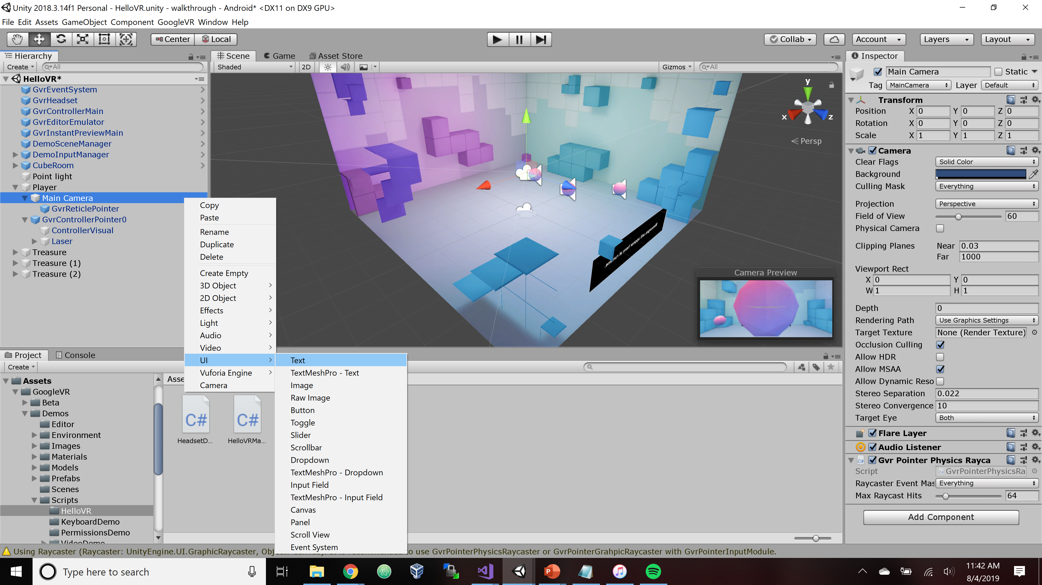
Add UI Text
Under main camera, right click, and add Text

Slide 15
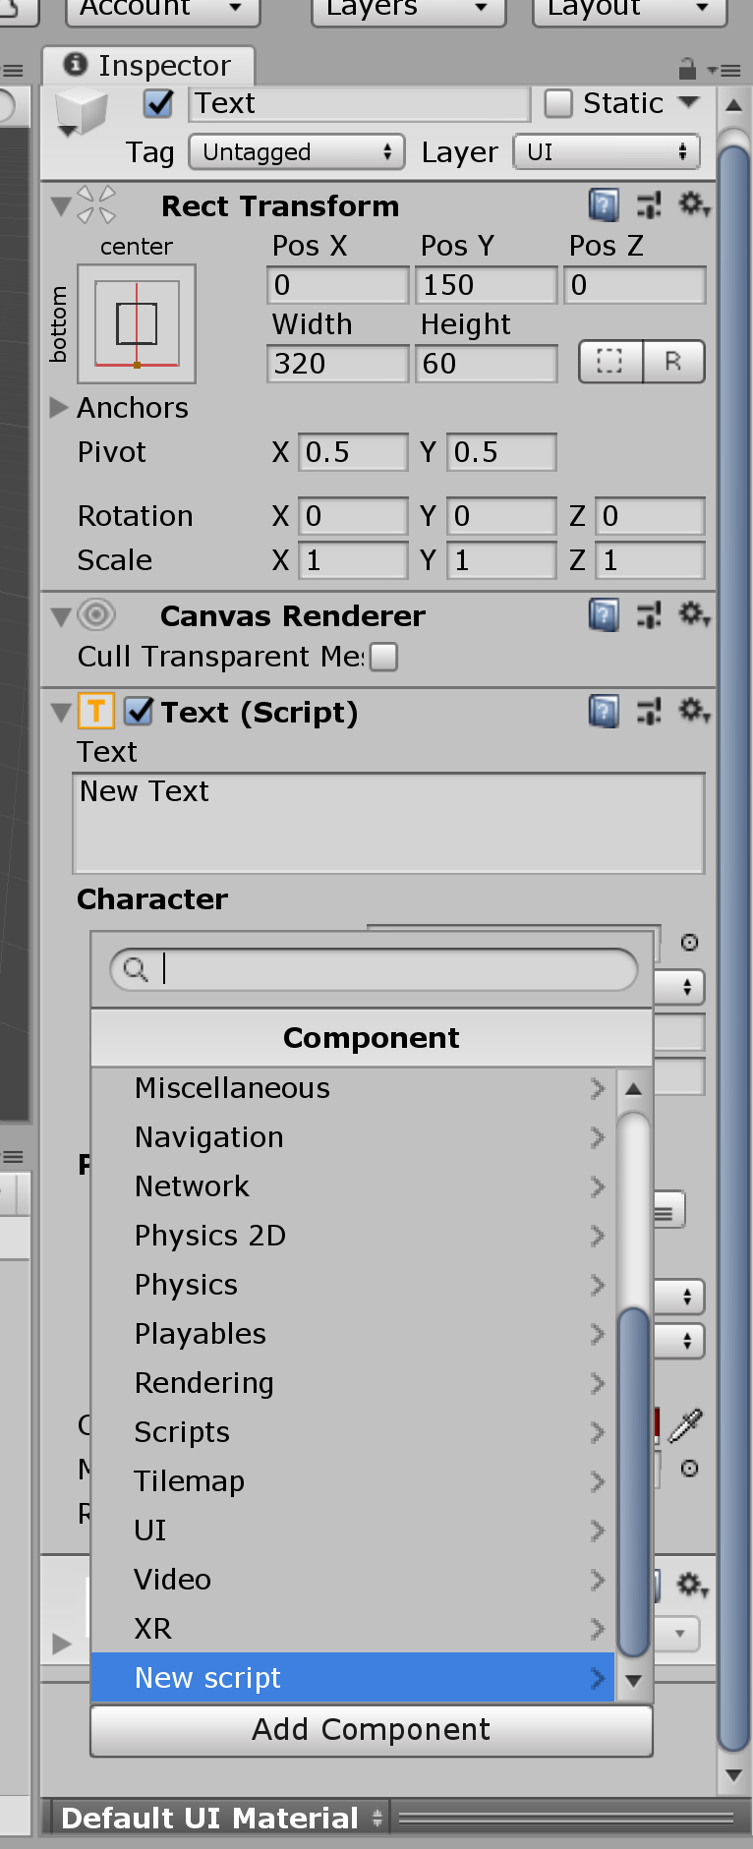
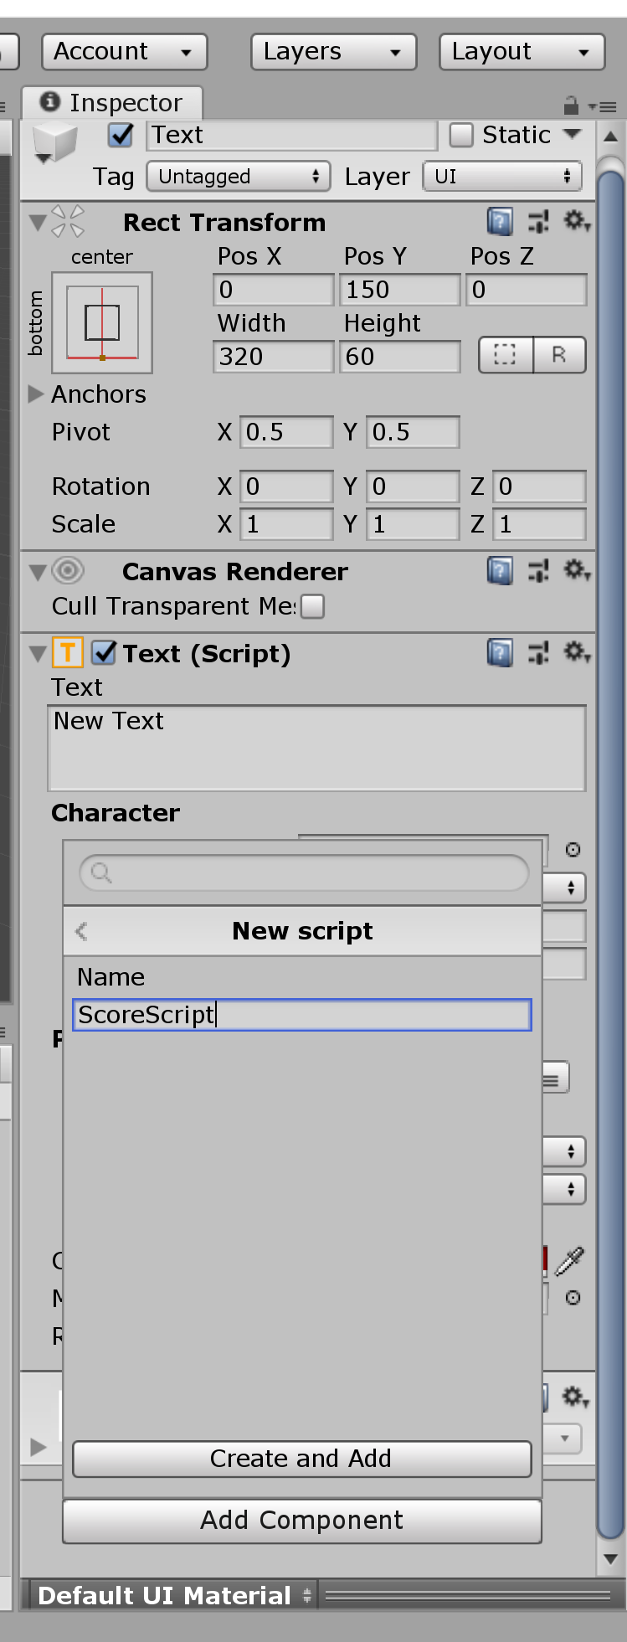
Add a script
Click “Add Component”
Select “New script”
Give it a name

Slide 16
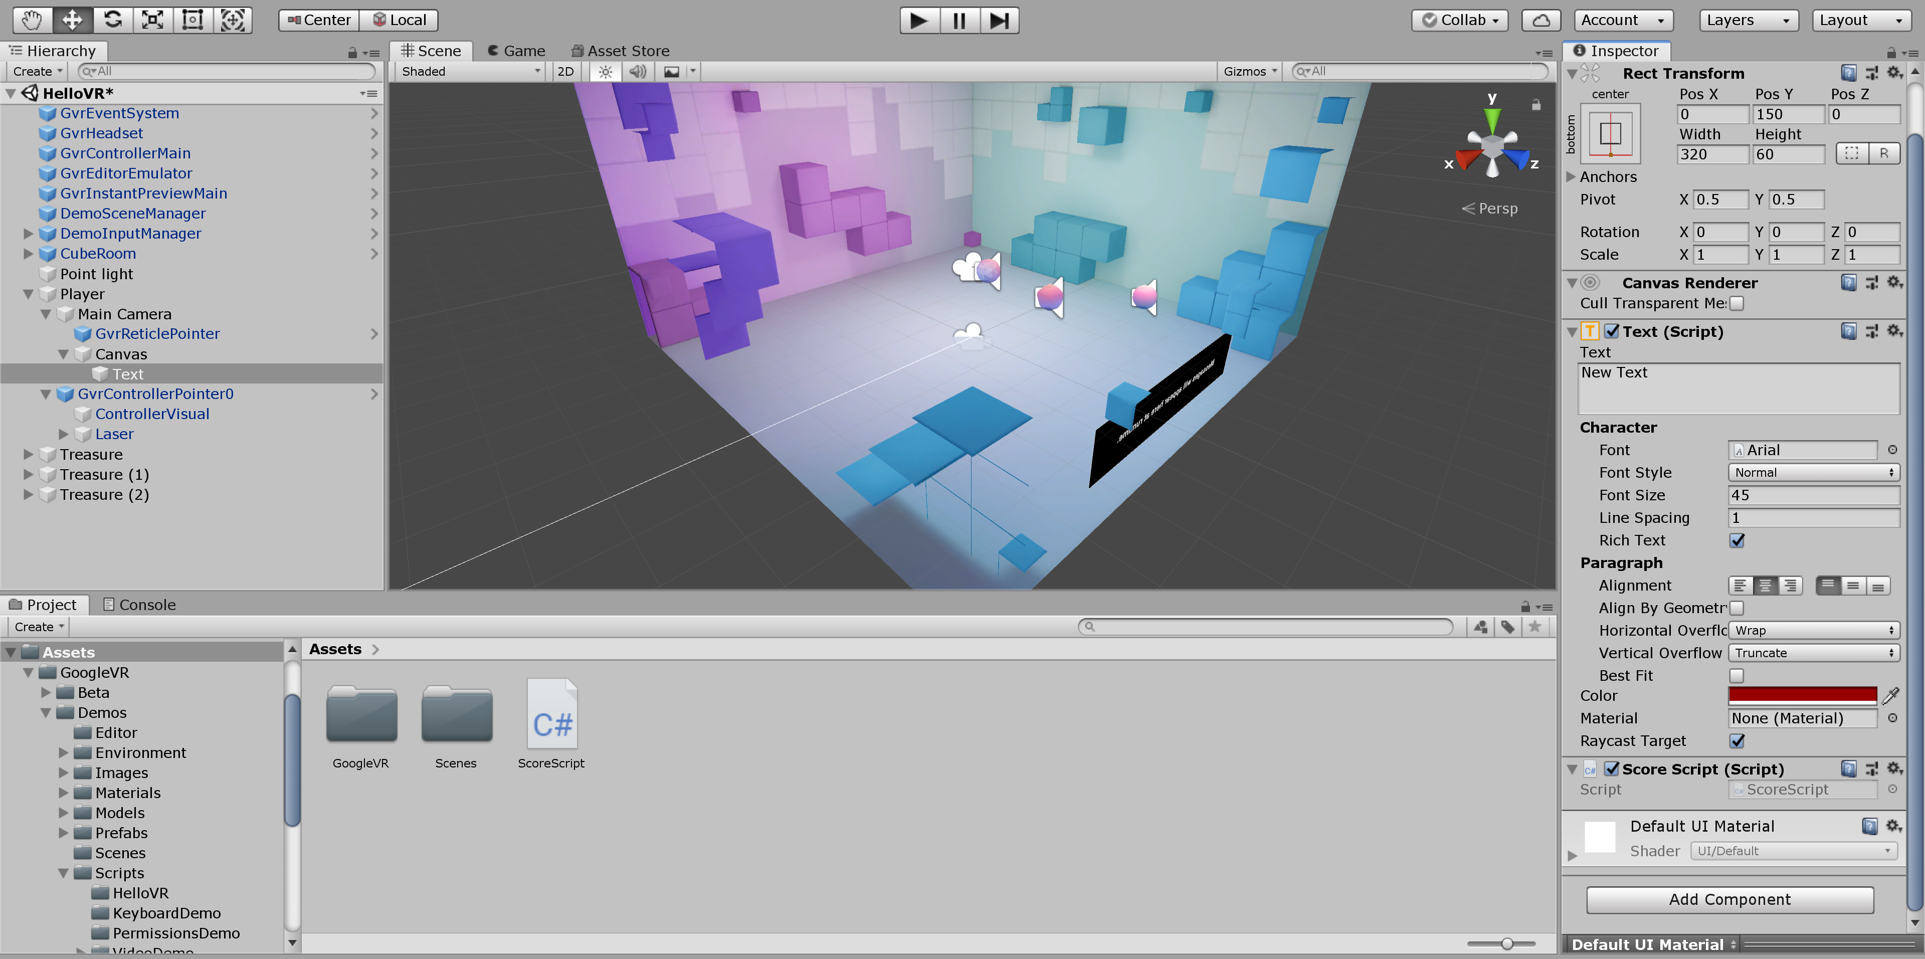
Navigate and Open Script
Double click script (by default, found under assets)

Slide 17
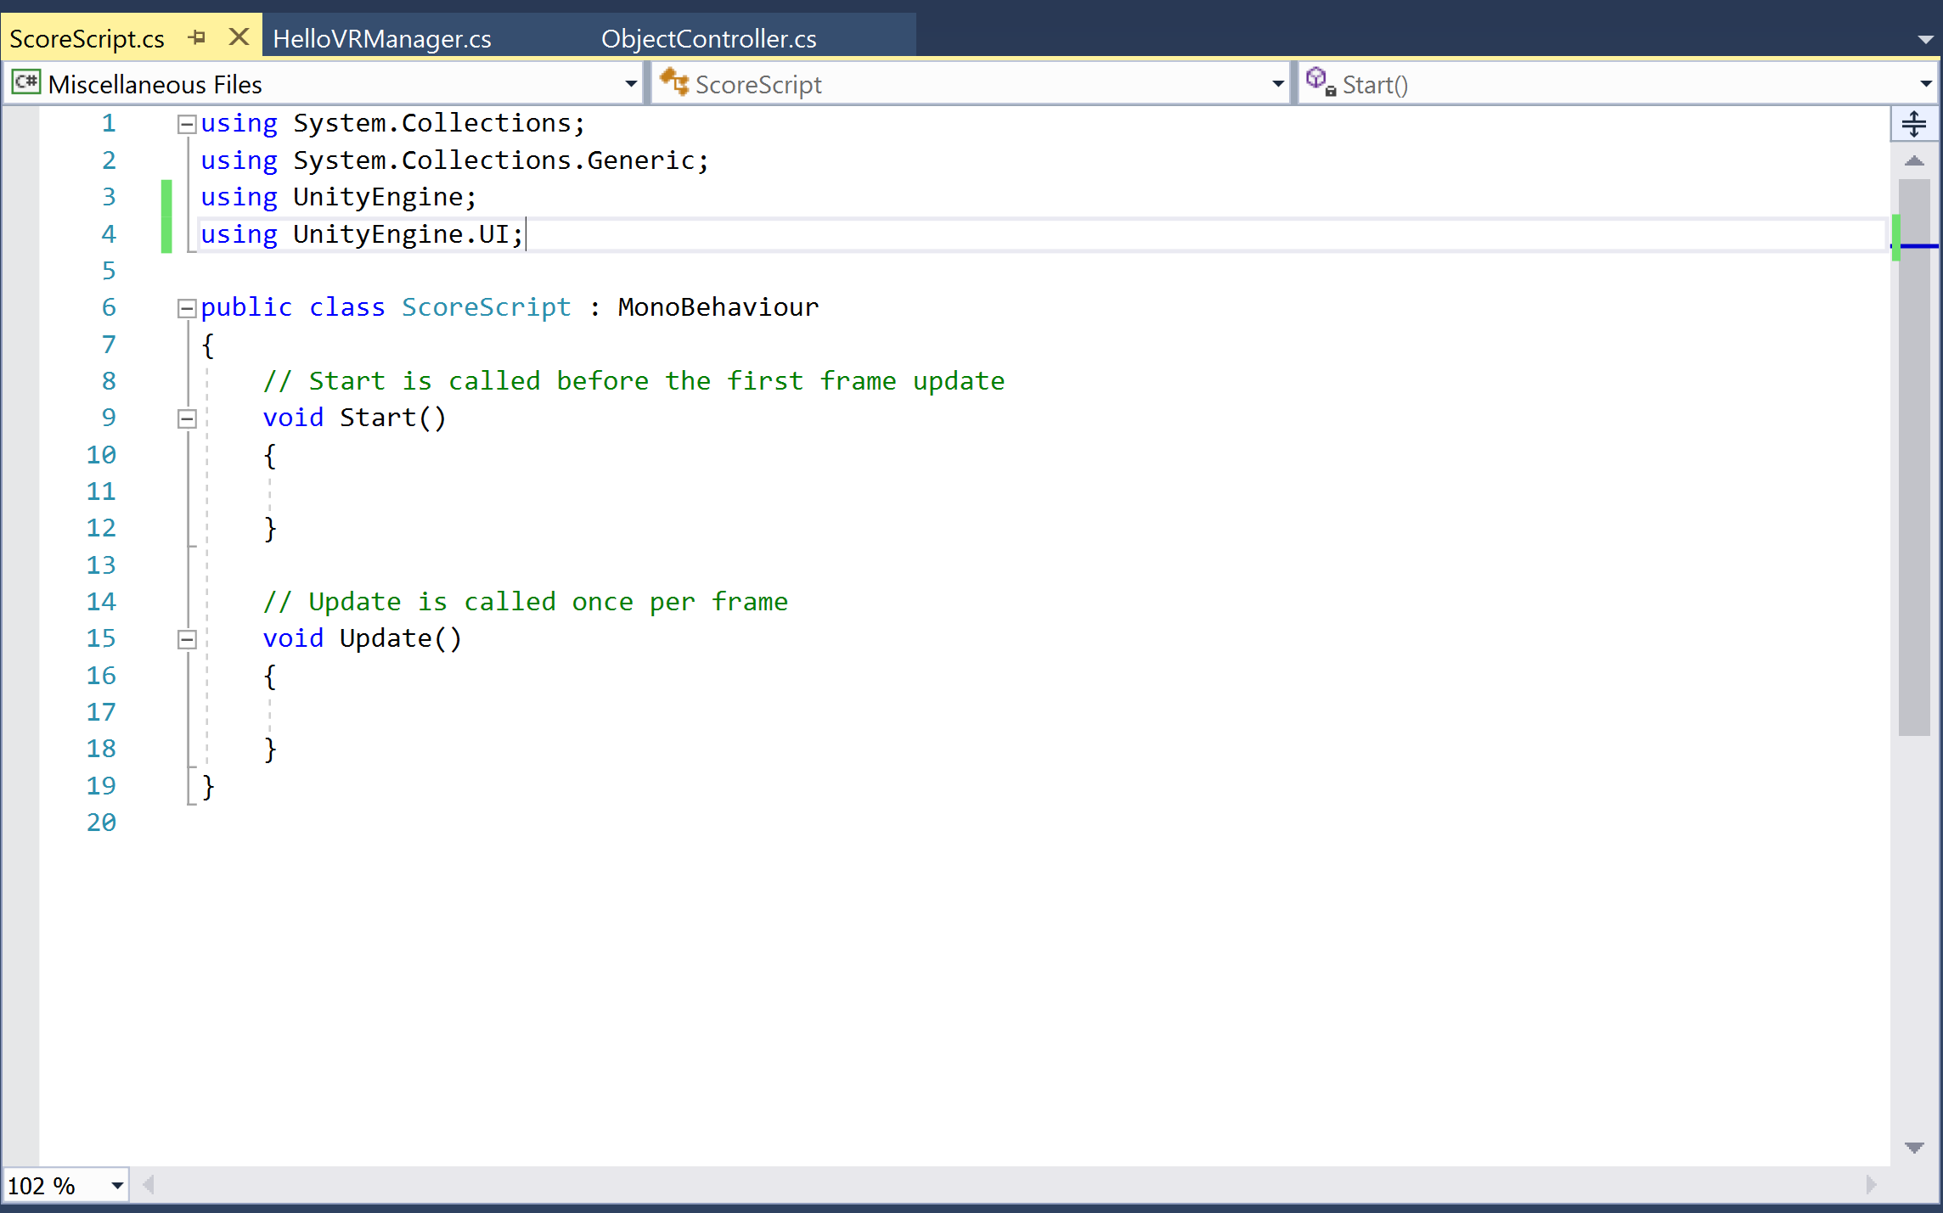
Include UnityEngine.UI

Slide 18
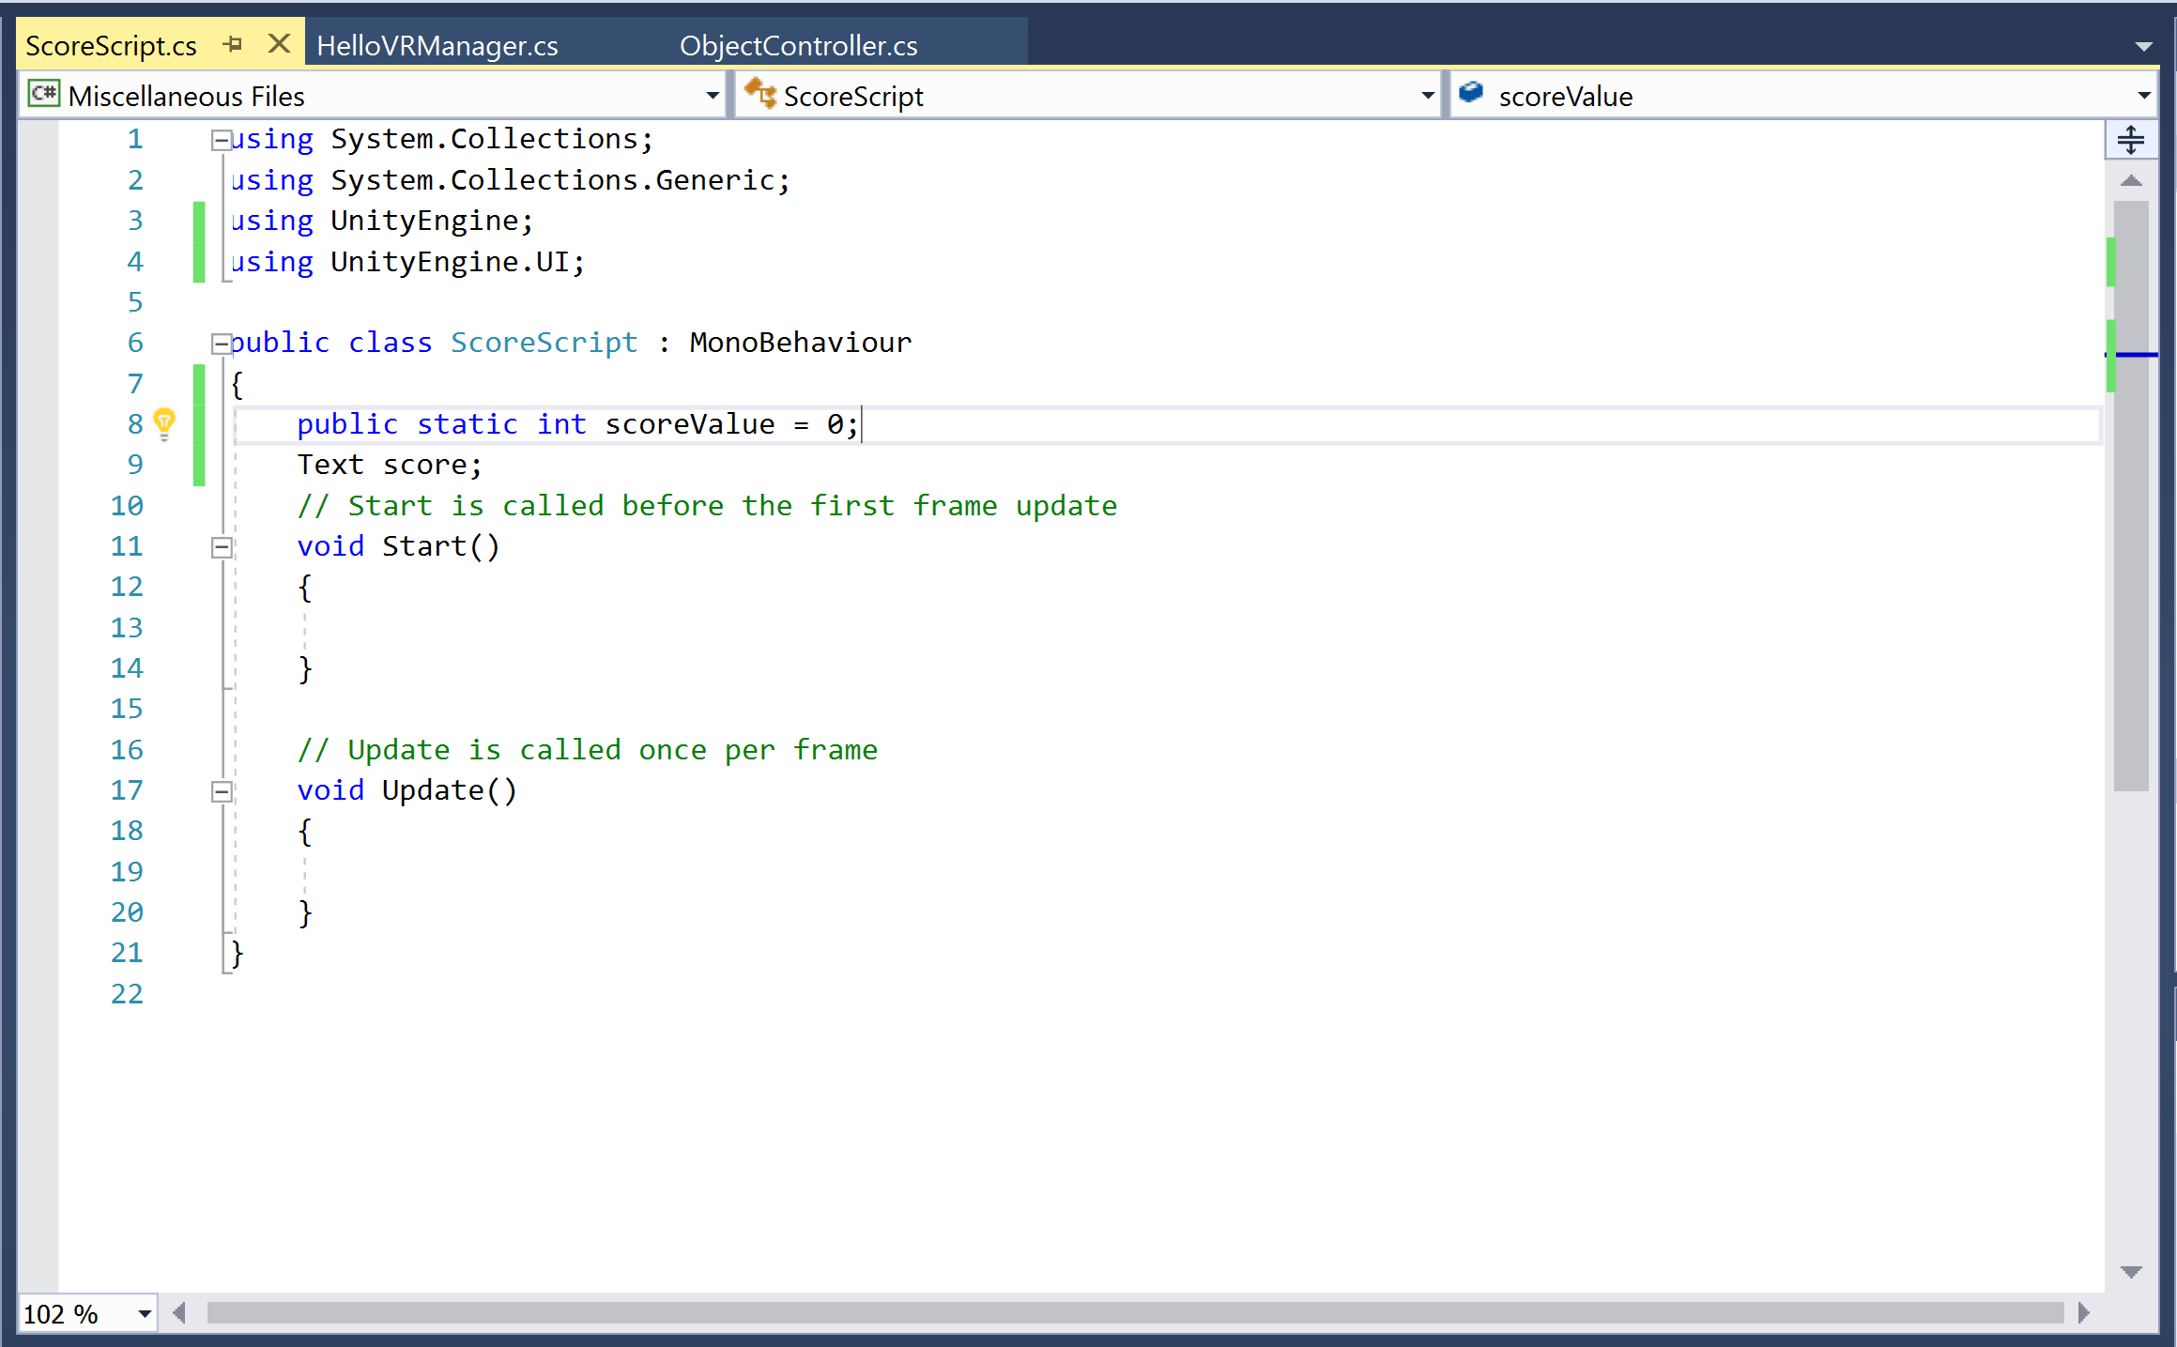
Add parameters
We need to keep track of the score
And a Text element to display to score

Slide 19
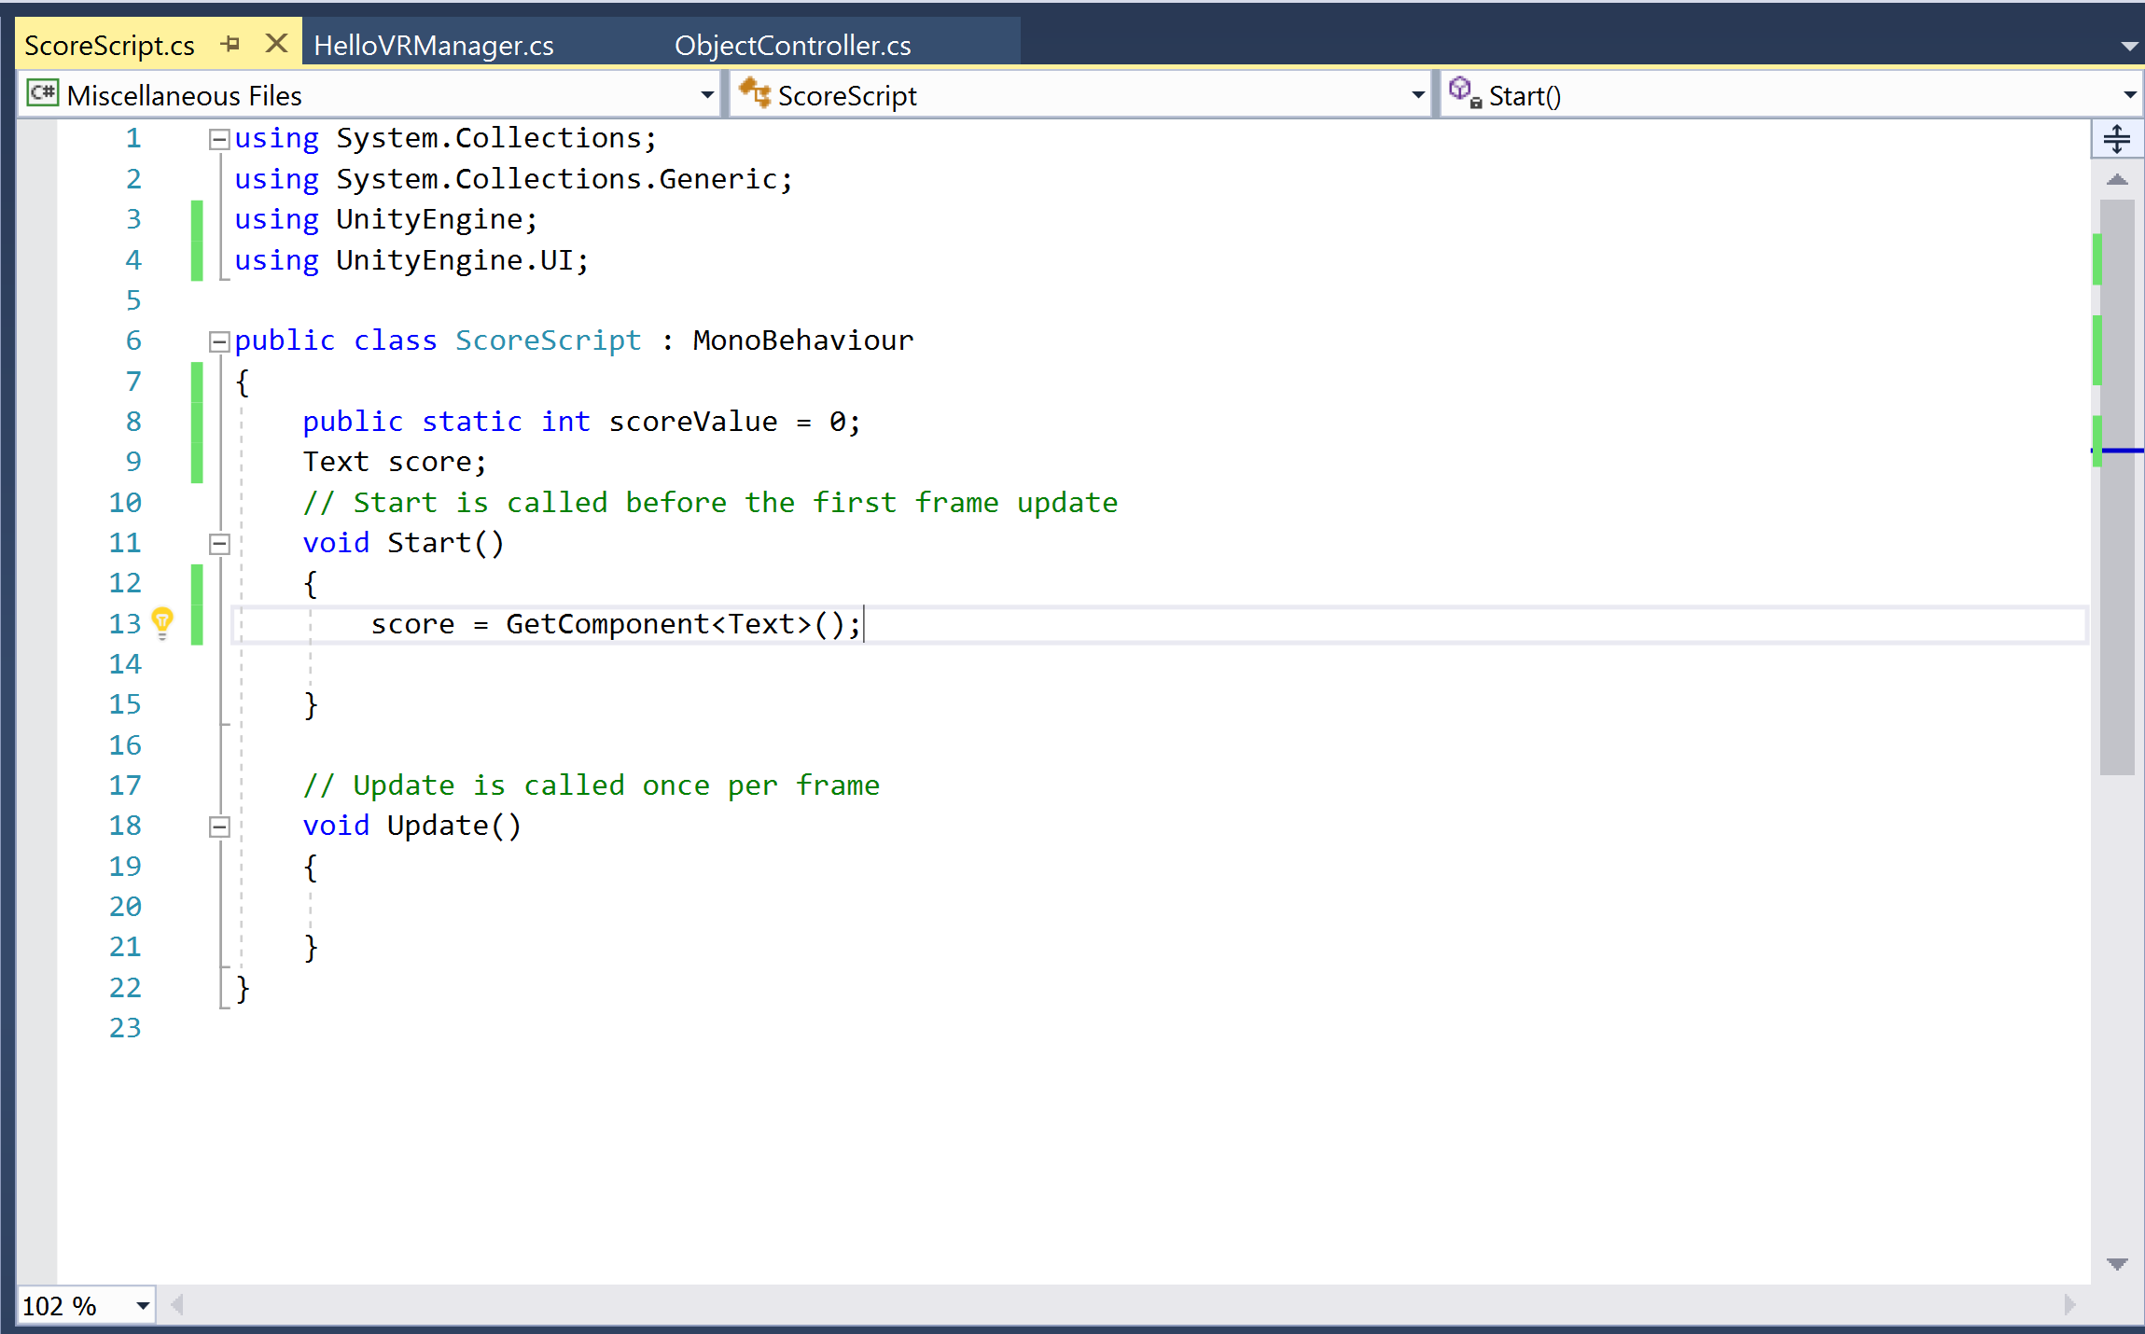
Start function
Set score to the Text component we created in the Unity editor

Slide 20
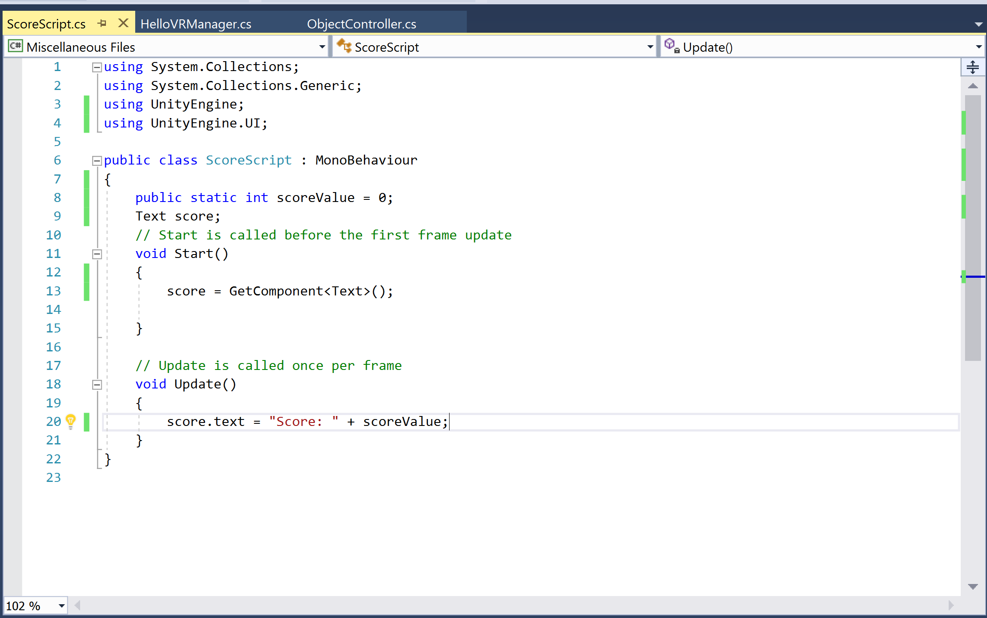
Update function
Set score’s actual text to display the current score value

Slide 21
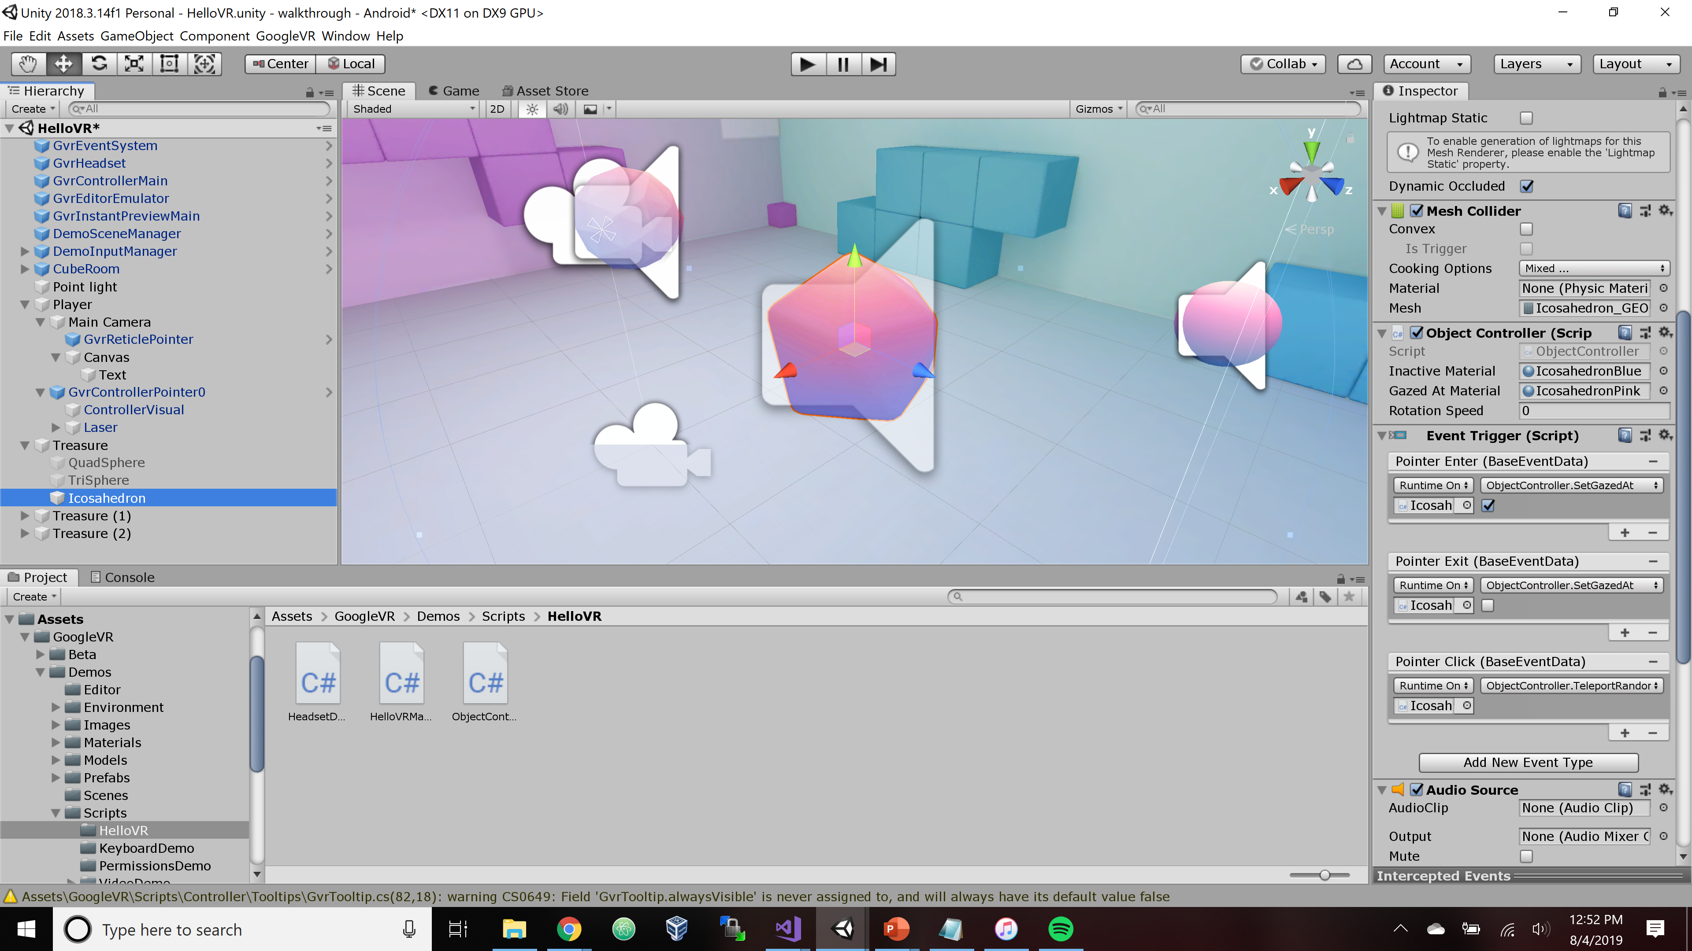
Now to actually update the score…
Find what is triggered during “click” event - open ObjectController script

Slide 22
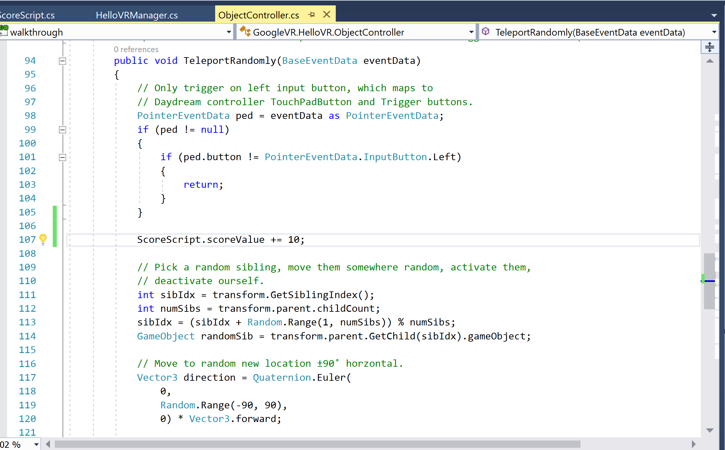
Now to actually update the score…
Find the TeleportRandomly function
After the pointer event data is checked, increment the score
Be sure since the score value was declared in a different class (what you named your script), make sure you identify it’s the class’s score value

Slide 23
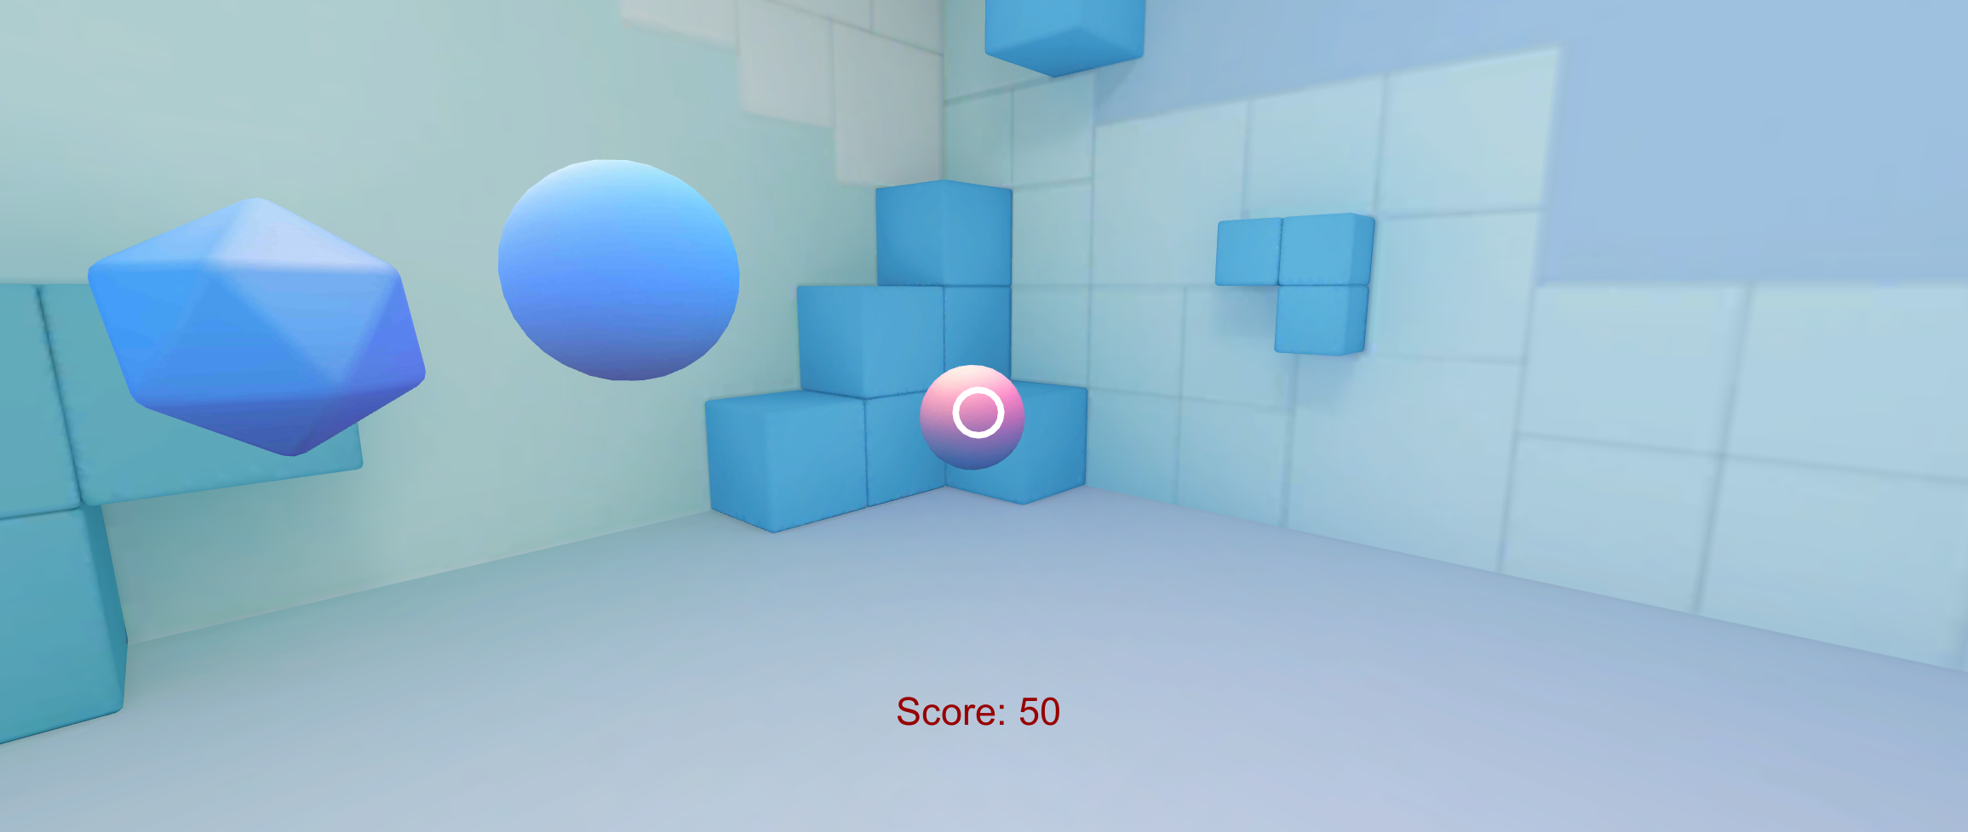
Now try it out!

